Slide 1
Remote Gas Pipeline Tunnel Temperature Monitoring System
presentation by
Ruchika Dubey
Manjushri Jiwane
Bhumika Mundada

Slide 2
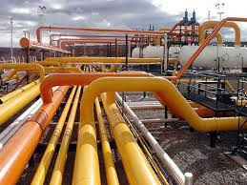
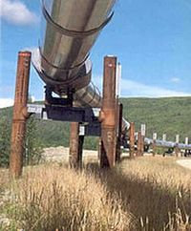
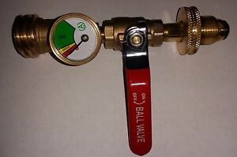
Pipeline Transport:
Pipeline transport is the long-distance transportation of a liquid or gas through a system of pipes,called as a pipeline typically to a market area for consumption.
Natural gas (LPG)is among the least expensive and most efficient ways to use in the kitchen . new ways are implemented to suppy them through pipelines in the buildings and houses as it is more cost effective in transporting
Gas Piping at home:

Slide 3
Advantages: Disadvantages :
Reduction in cost of transportation is very significant.
Supply through pipelines is very reliable.
In case of underground pipelines, the land in which pipeline is laid can still be used .
It ensures supply in remote areas where road ways are not very good, also it provides safe and secure supply for defence needs.
gas on the pipeline 30% cheaper than an LPG cylinder.
Illegal pilferage and wastage due to leak is a problem in pipelines.
Like other big linear structures patrolling and maintenance of pipelines is a huge task.
In case of chemicals and petroleum pipelines any leak can cause a accident .

Slide 4

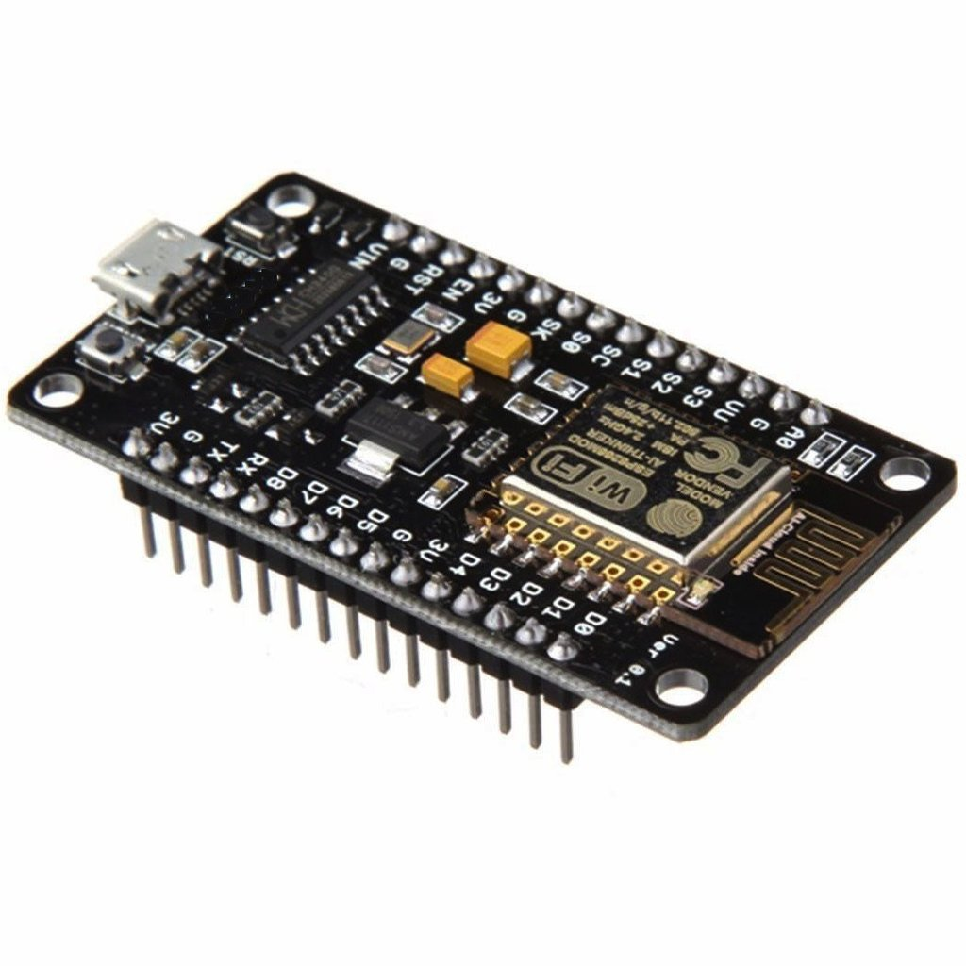

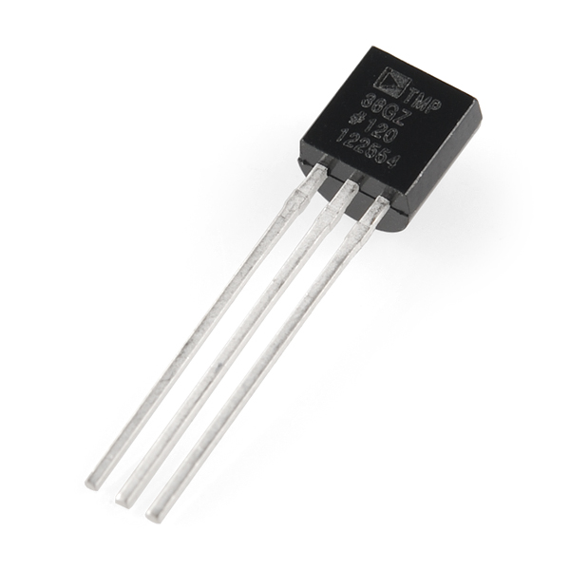
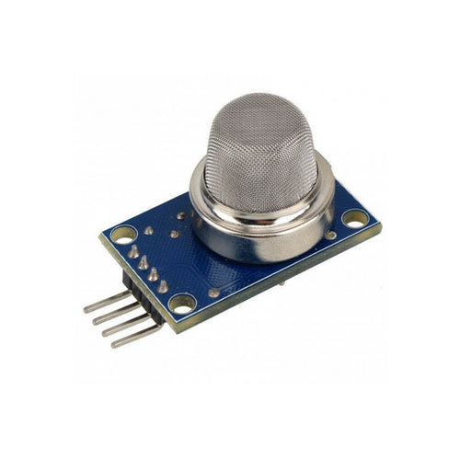
Working Of The Project:

Slide 5
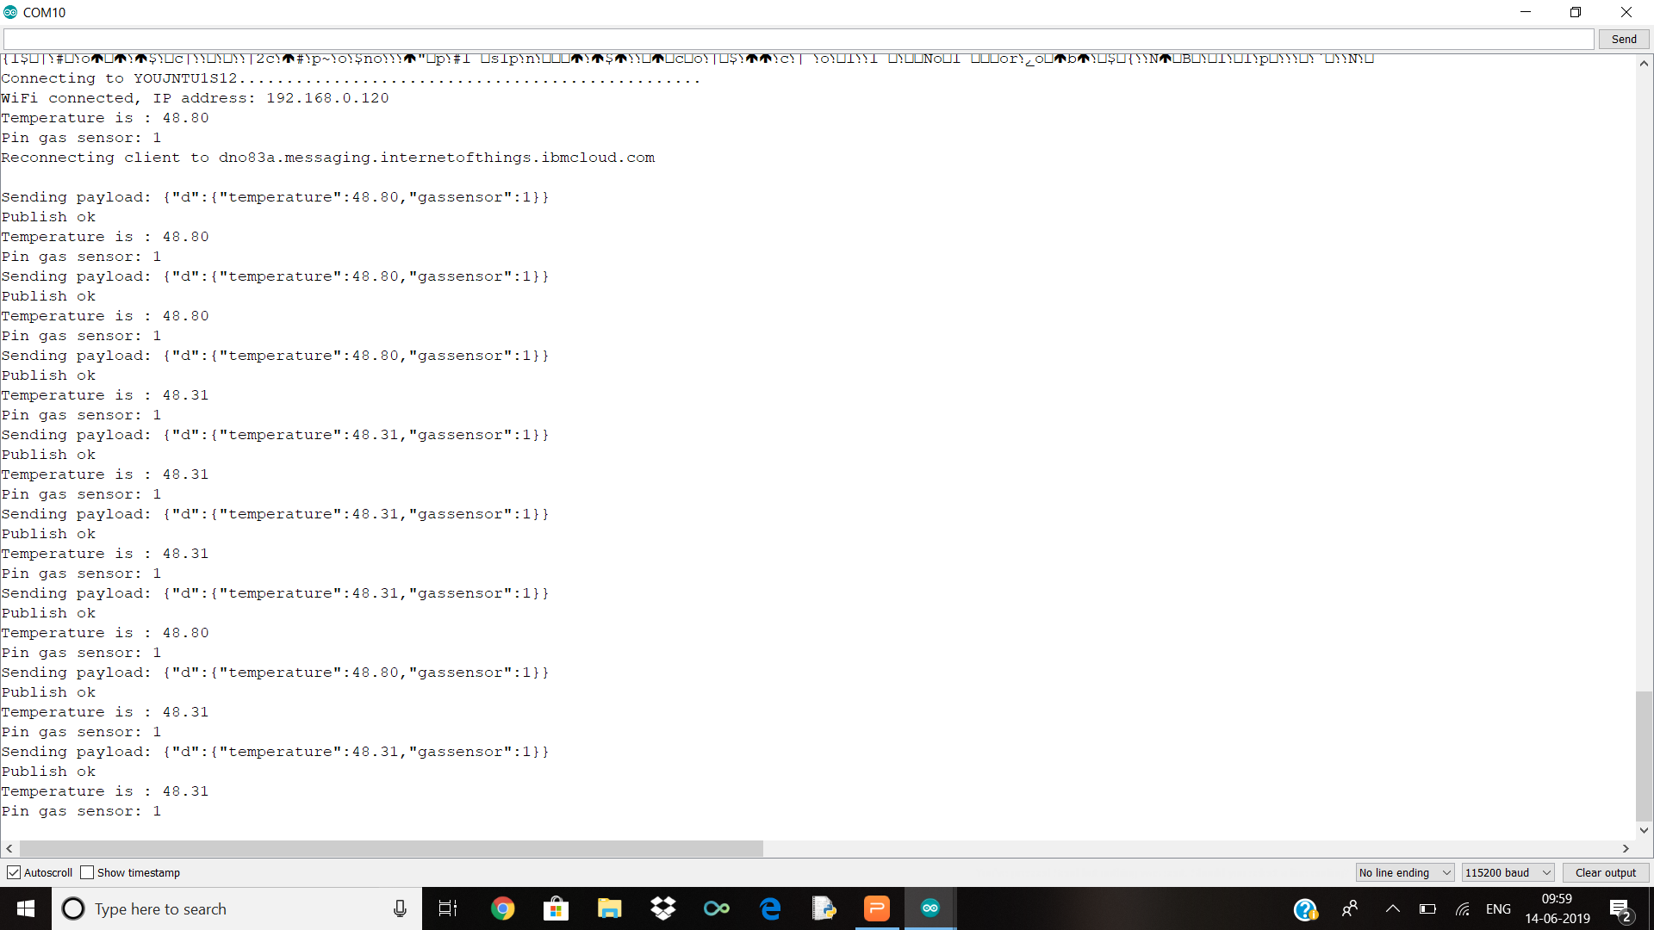
Serial Moniter:

Slide 6
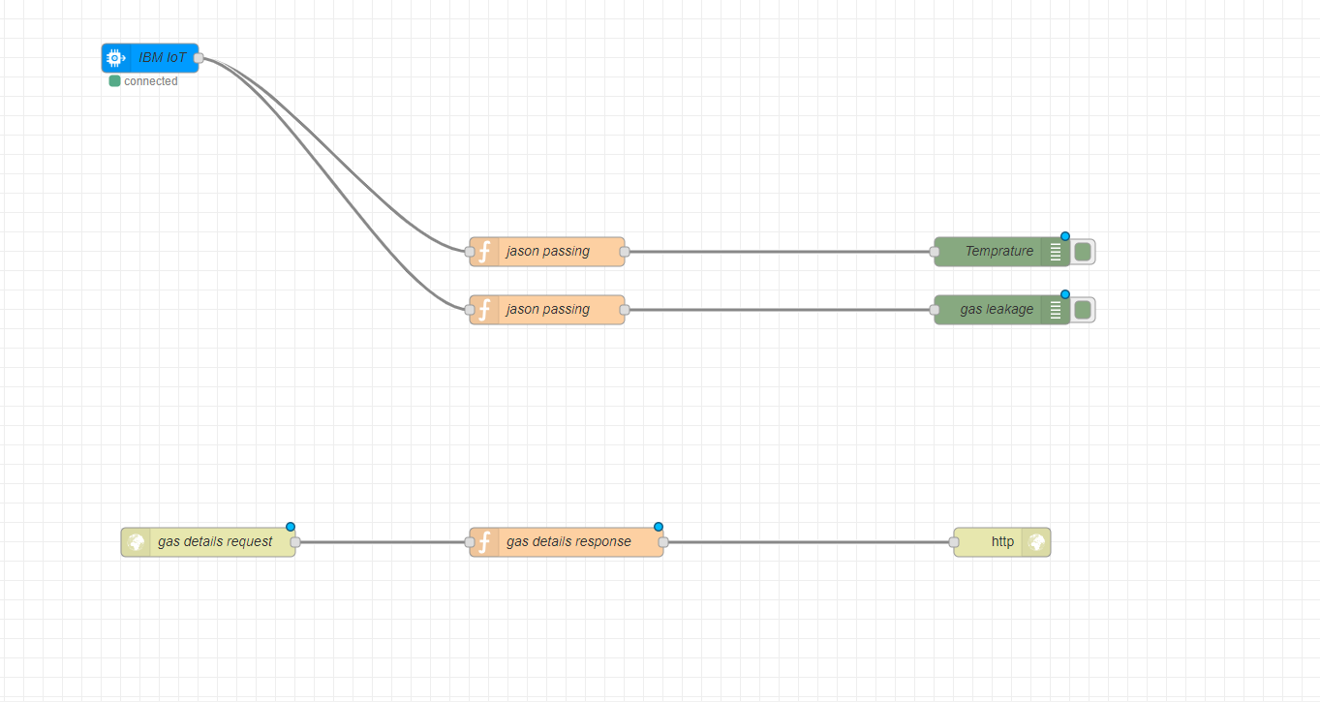
NODE RED FLOW:

Slide 7
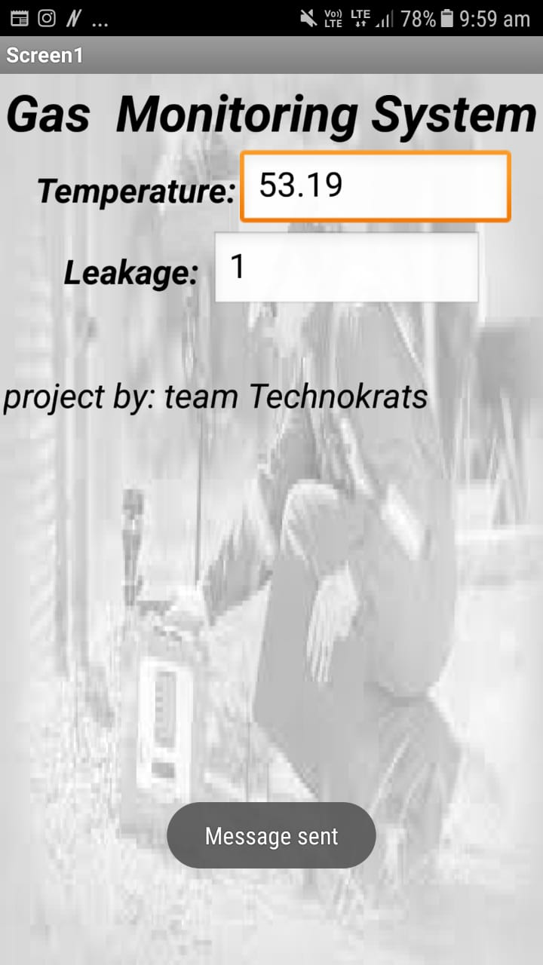
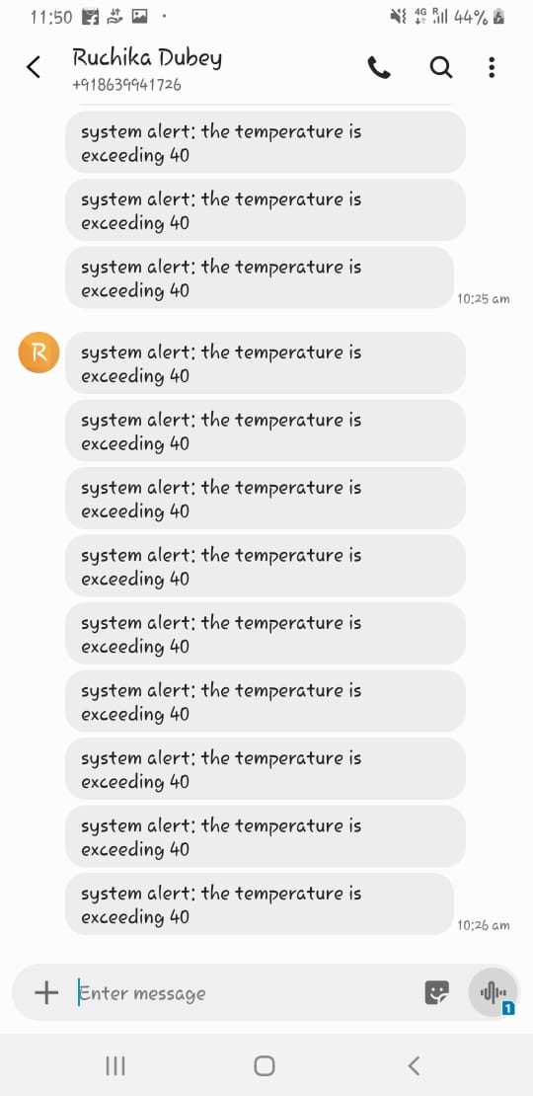
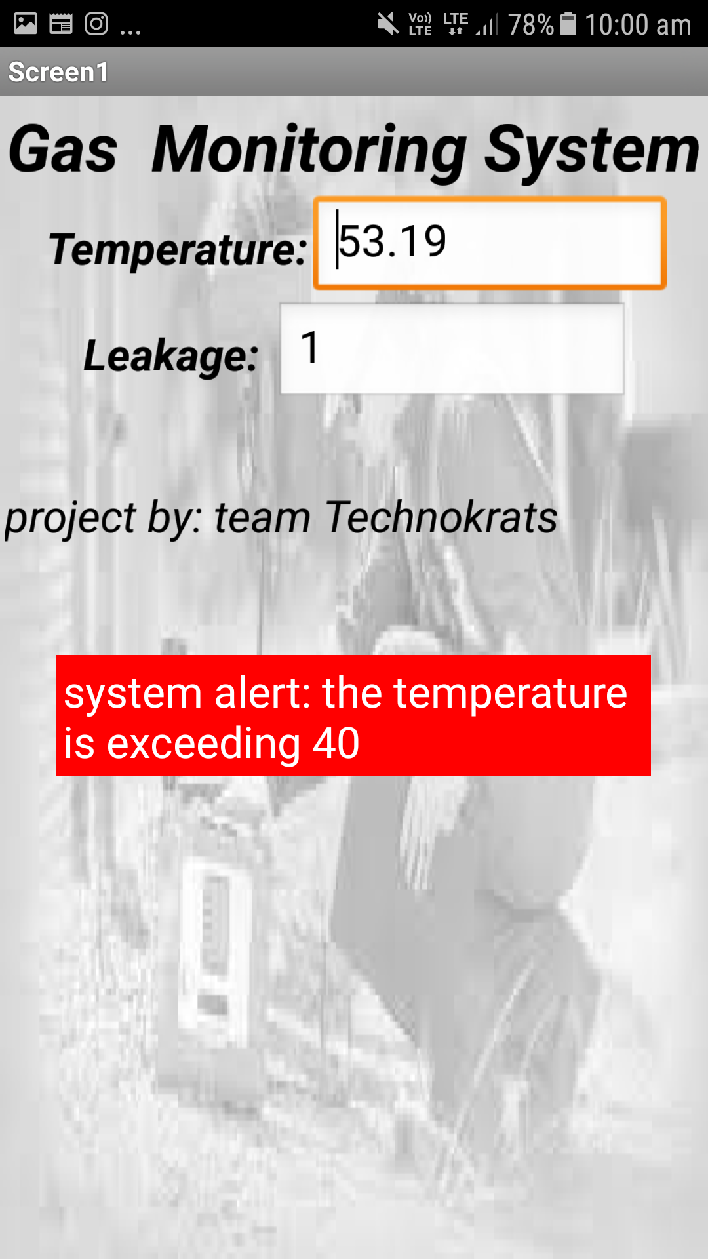
Mobile App:

Slide 8
Advantages Of The Project :
wastage due to leak in pipelines can be rectified as we can detect the leakage and take actions accordingly.
maintenance of pipelines can be easily done as we can detect where it should be repaired.
we can know where the temperature is exceeding or where there is a leakage and accident can be prevented.
pipeline operators frequently face false alarms whereby the sensors are hypersensitive and To overcome this challenge, the use of wireless and remote technologies are becoming more prevalent.

Slide 9
Future Scope:
The length of total Natural Gas Pipelines was 10246 Kms in India as on 31st March 2010 which increased by 17680.397 Kms as on 31st March 2016, so in the future there are a lot of projects to implement more pipeline transport in India so by the implementation of the project we can prevent leakage as well as accidents in future.
gas on the pipeline is actually turning out to be 30% cheaper than an LPG cylinder so in future more people will go for gas pipeline than LPG

Slide 10
THANK YOU!

